Slide 1

ANNAMACHARYA INSTITUTE OF TECHNOLOGY AND SCIENCES::TIRUPATI (AUTONOMOUS) Artificial Intelligence & Data Science A.Y.: 2025-2026 SECOND REVIEW A Text-to-image Generators in the Development of the Usability Interface
Under the Guidance of
Ms.K.Gangothri , MCA
Assistant Professor
Department of AI&DS
AITS, Tirupati
Head of the Department
Ms. B. Rupa Devi Singh, M.Tech., (Ph.D) Associate Professor
Department of AI&DS
AITS, Tirupati
BATCH NO: 11
22AK1A3057 Y. Narayana Vara Prasad Reddy
22AK1A3065 V. Prabhas
22AK1A3074 S. Saleem Basha
22AK1A3092 k. Venkata Ashish Raj

Slide 2
MODEL DEVELOPMENT
Algorithms Used:
Stable Diffusion (Implemented Model)
Stable Diffusion is a deep learning–based generative model used for text-to-image generation. It converts natural language prompts into images using a diffusion process that transforms random noise into meaningful images. (Used version Stable Diffusion v1.5)
Core Components of the Model
1. CLIP Text Encoder(Contrastive Language–Image Pre-training)
Converts input text prompt into numerical embeddings
Provides semantic understanding of the prompt
2. UNet Diffusion Network
Core neural network of the diffusion model
Performs iterative denoising to generate image structure
3. Variational Autoencoder (VAE)
Converts latent representation into final RGB image
Enables efficient image generation in compressed latent space

Slide 3
Model Selection & Justification
Selected Model:
Stable Diffusion v1.5
Why Stable Diffusion Was Selected
1. High Image Quality
Generates detailed and realistic images from text prompts.
2. Stable Generation Process
Diffusion models are more stable compared to GAN training.
3. Efficient Latent Diffusion Architecture
Operates in latent space, reducing computational cost.
4. Pretrained Model Availability
Pretrained models are available through HuggingFace.
5. Easy Integration
Can be integrated with Python frameworks like PyTorch and Diffusers.

Slide 4
Hyperparameter Tuning
Hyperparameters Used in Image Generation
Hyperparameters control how the Stable Diffusion model generates images from text prompts. Proper tuning improves image quality, prompt accuracy, and generation stability.
1. Number of Inference Steps
num_inference_steps = 45
Determines how many denoising steps are used during the diffusion process.
Higher steps → better image quality but slower generation.
2. Guidance Scale
guidance_scale = 8.5
Controls how strongly the model follows the text prompt.
Higher value improves prompt accuracy.
3. Prompt Structure
Example prompt used in the system:
"A modern house icon, clean vector illustration, minimal color palette"
Well-structured prompts improve style consistency and image relevance.

Slide 5
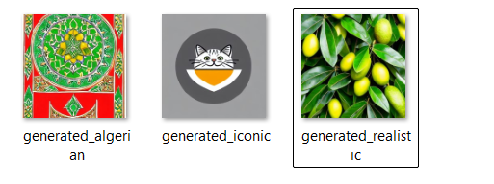
Performance Results
Performance Results:
The model successfully generated UI images from text prompts.
Generated images showed good relevance and visual quality
Style consistency was achieved after DreamBooth fine-tuning
Image generation time was around 10 minutes per output.

Slide 6
Model Comparison
Why Stable Diffusion Performs Better
Uses latent diffusion architecture, reducing computational cost.
Produces high-quality and detailed images from text prompts.
More stable generation process compared to GAN models.
Easily integrated with Python and web frameworks like Django.
Method | Advantages | Limitations
Manual Design | High control over design | Time-consuming and requires design skills
GAN-based Models | Can generate realistic images | Training instability and mode collapse
DALL·E (Transformer) | Powerful multimodal model | Limited open access and high computational cost
Stable Diffusion (Proposed) | High-quality images, efficient latent diffusion, open-source | Requires GPU for faster generation

Slide 7
Deployment Strategy
Model :
The Stable Diffusion pretrained model is loaded using PyTorch and HuggingFace Diffusers.
Model weights are initialized during system startup to enable efficient text-to-image inference.
Deployment Framework:
The application is deployed as a Django-based web system.
Django handles user requests, prompt processing, and communication with the AI model.
Tools Used :
Backend Framework – Django
Processes user text prompts and sends them to the Stable Diffusion model.
Manages server-side logic and displays generated images on the web interface.
AI Model – Stable Diffusion (PyTorch)
Diffusion-based generative model that converts text prompts into images.
Implemented using PyTorch and HuggingFace Diffusers library.

Slide 8
Deployment Strategy
System Environment
Runs in a GPU-enabled environment to accelerate the image generation process.
Technologies Used
Backend
Python – Implements the AI pipeline and model inference.
Django – Handles server operations, routing, and model integration.
Frontend
HTML – Defines the structure of web pages.
CSS – Provides styling and layout.
JavaScript – Enables dynamic interaction and image display.

Slide 9
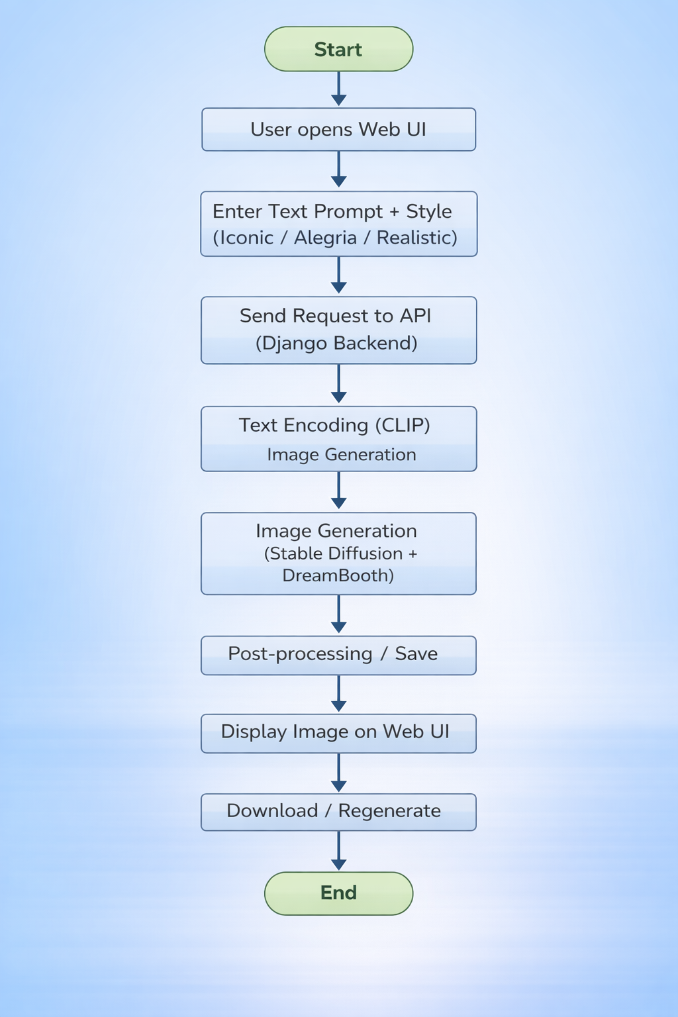
Integration Process
Integration Process
Workflow:
User opens the web application ⬇ Enter text prompt ⬇ Select image style (Iconic / Alegria / Realistic) ⬇ Submit prompt ⬇ Backend processes request ⬇ Stable Diffusion generates image ⬇ Generated image displayed on UI ⬇ User can download or regenerate image

Slide 10
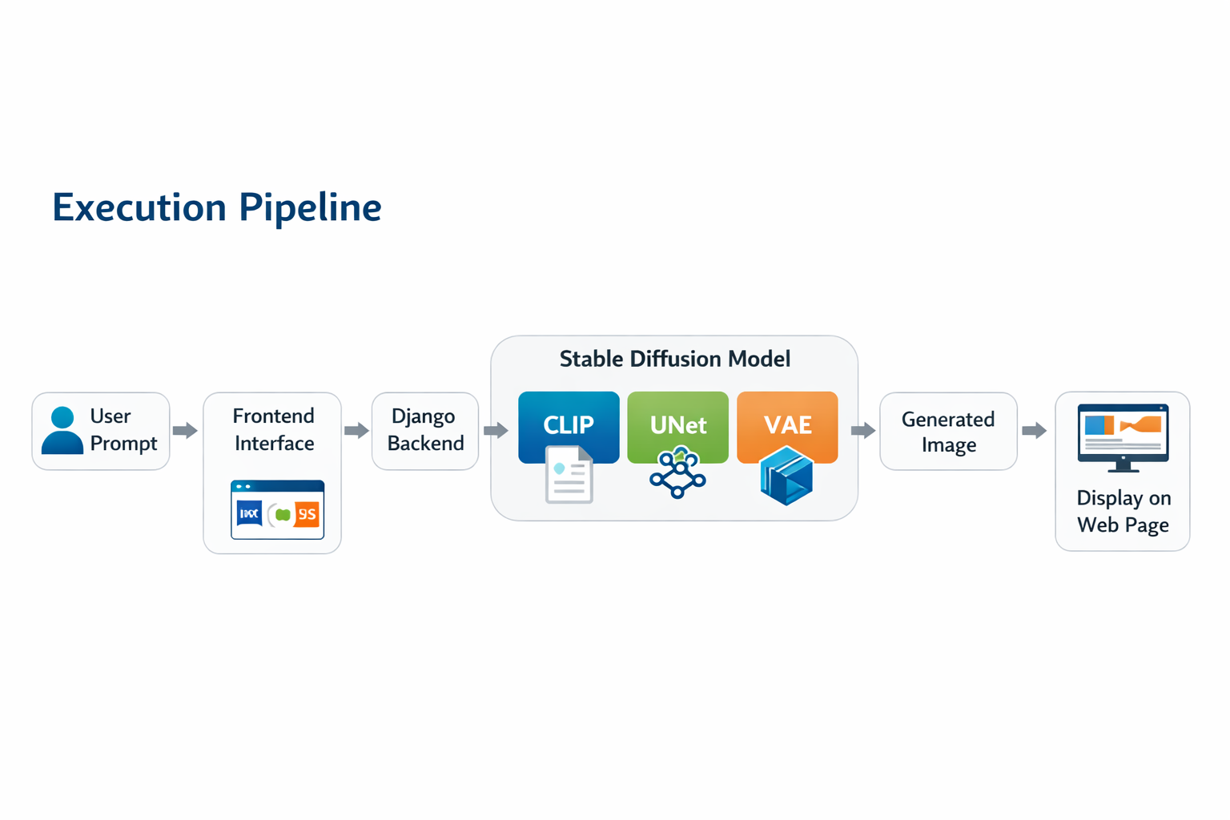

Slide 11
CONCLUSION
Conclusion
Project Summary
Successfully developed a Text-to-Image Generation System using the Stable Diffusion model.
The system converts natural language prompts into meaningful images using diffusion-based generative AI.
Implemented a web-based interface using Django for user interaction and image visualization.
Key Achievements
Integrated Stable Diffusion with a Django web application.
Generated images that closely match the given text prompts.
Reduced the need for manual image design in usability interfaces.
Demonstrated a practical application of Generative AI in web development.
Final Outcome
The project demonstrates how diffusion-based generative models can automate image creation from text, improving efficiency and enabling new possibilities in UI development and creative applications.

Slide 12
FUTURE SCOPE
Possible Enhancements
Support for Additional Image Styles Extend the system to generate images in more artistic and design styles.
Advanced Prompt Engineering Improve prompt design techniques to generate more accurate and detailed images.
Real-Time Image Generation Optimize the system to generate images faster for real-time applications.
Cloud Deployment Deploy the system on cloud platforms to improve scalability and accessibility.
Multimodal Extensions Extend the system to support text-to-video or text-to-3D generation.

Slide 13
Thank You

